Slide 1







Financing Your Future

Slide 2



Funding for this workshop
is provided by:
National Council on Economic Education
Citi Foundation
Illinois CIBER
University of Illinois Extension

Slide 3
Instructors
Dr. Angela Lyons Associate Professor, University of Illinois (217) 244-2612; anglyons@illinois.edu
Debra Bartman Extension Educator, Quad Cities Center (309) 792-2500 (x217); dbartman@illinois.edu
Patricia Hildebrand Extension Educator, Effingham Extension Center (217) 347-5126; phildebr@illinois.edu

Slide 4
Financing Your Future
5 videos
15 lesson plans – 3 for each video
Glossary of terms
Test bank (pre- and post-test questions)
Table of correlations to learning standards for economics, mathematics, and personal finance

Slide 5
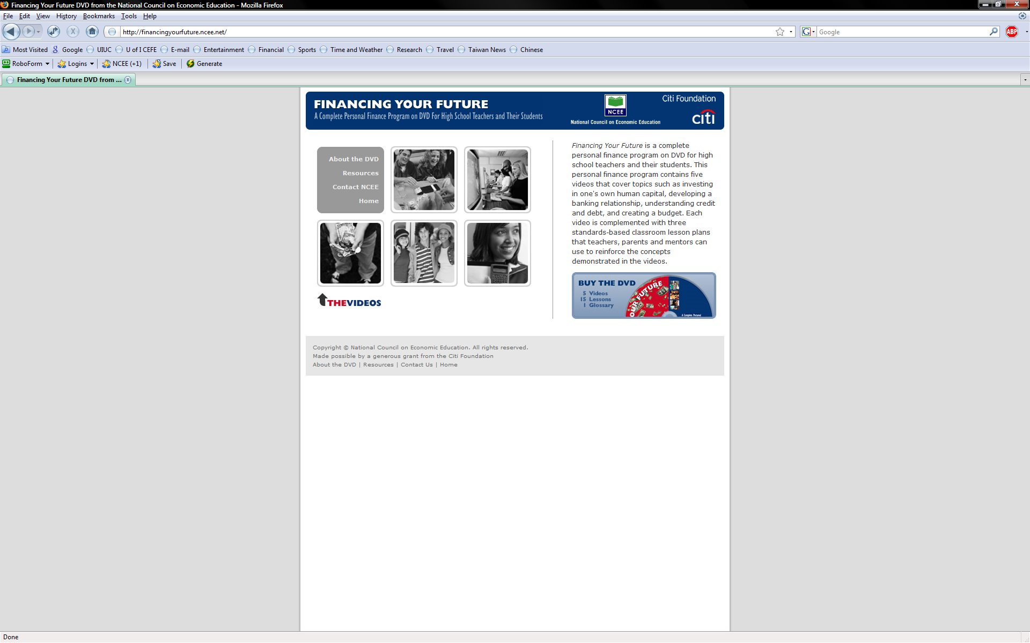
Financing Your Future Website
http://financingyourfuture.ncee.net/

Slide 6
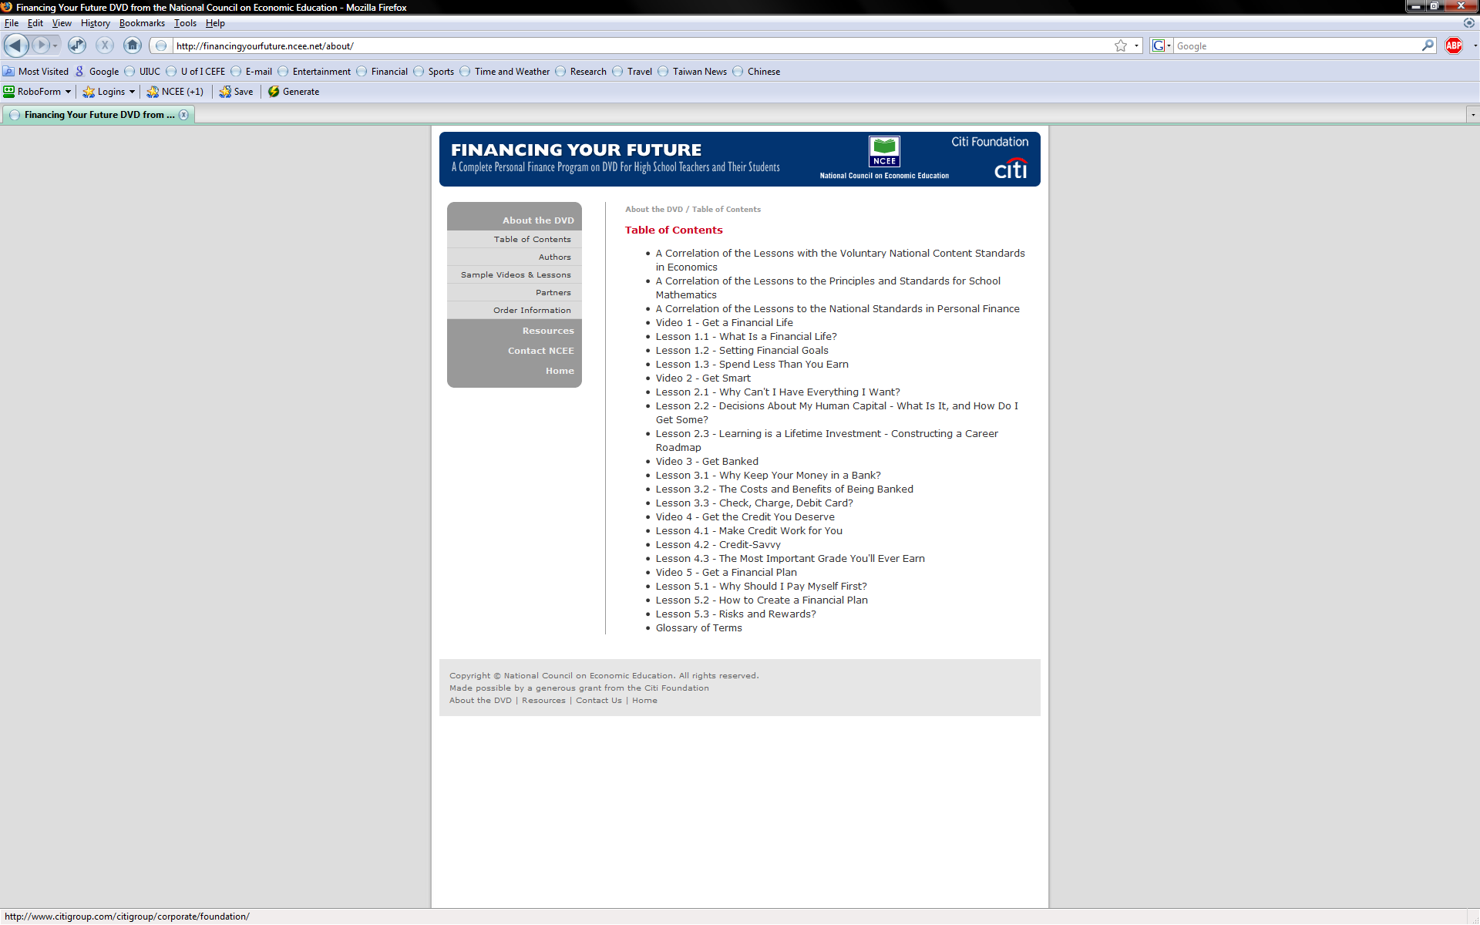
Table of Contents

Slide 7
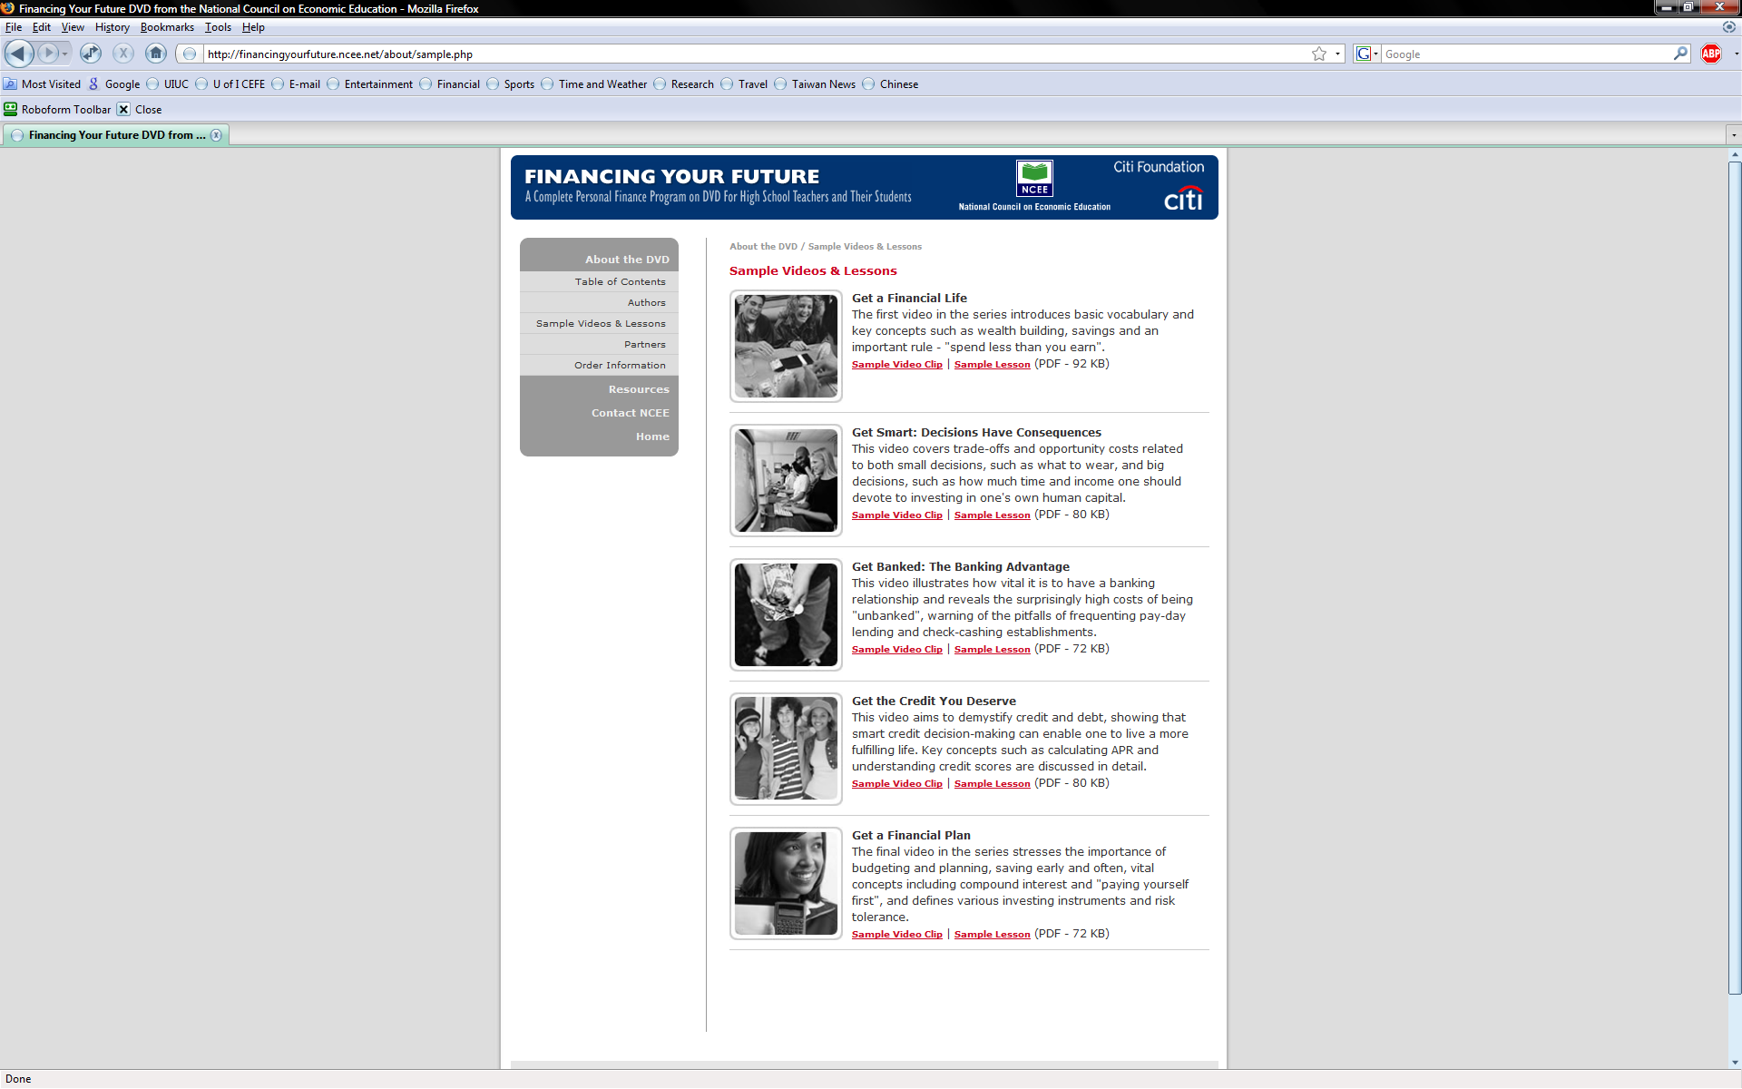
Sample Videos & Lessons

Slide 8
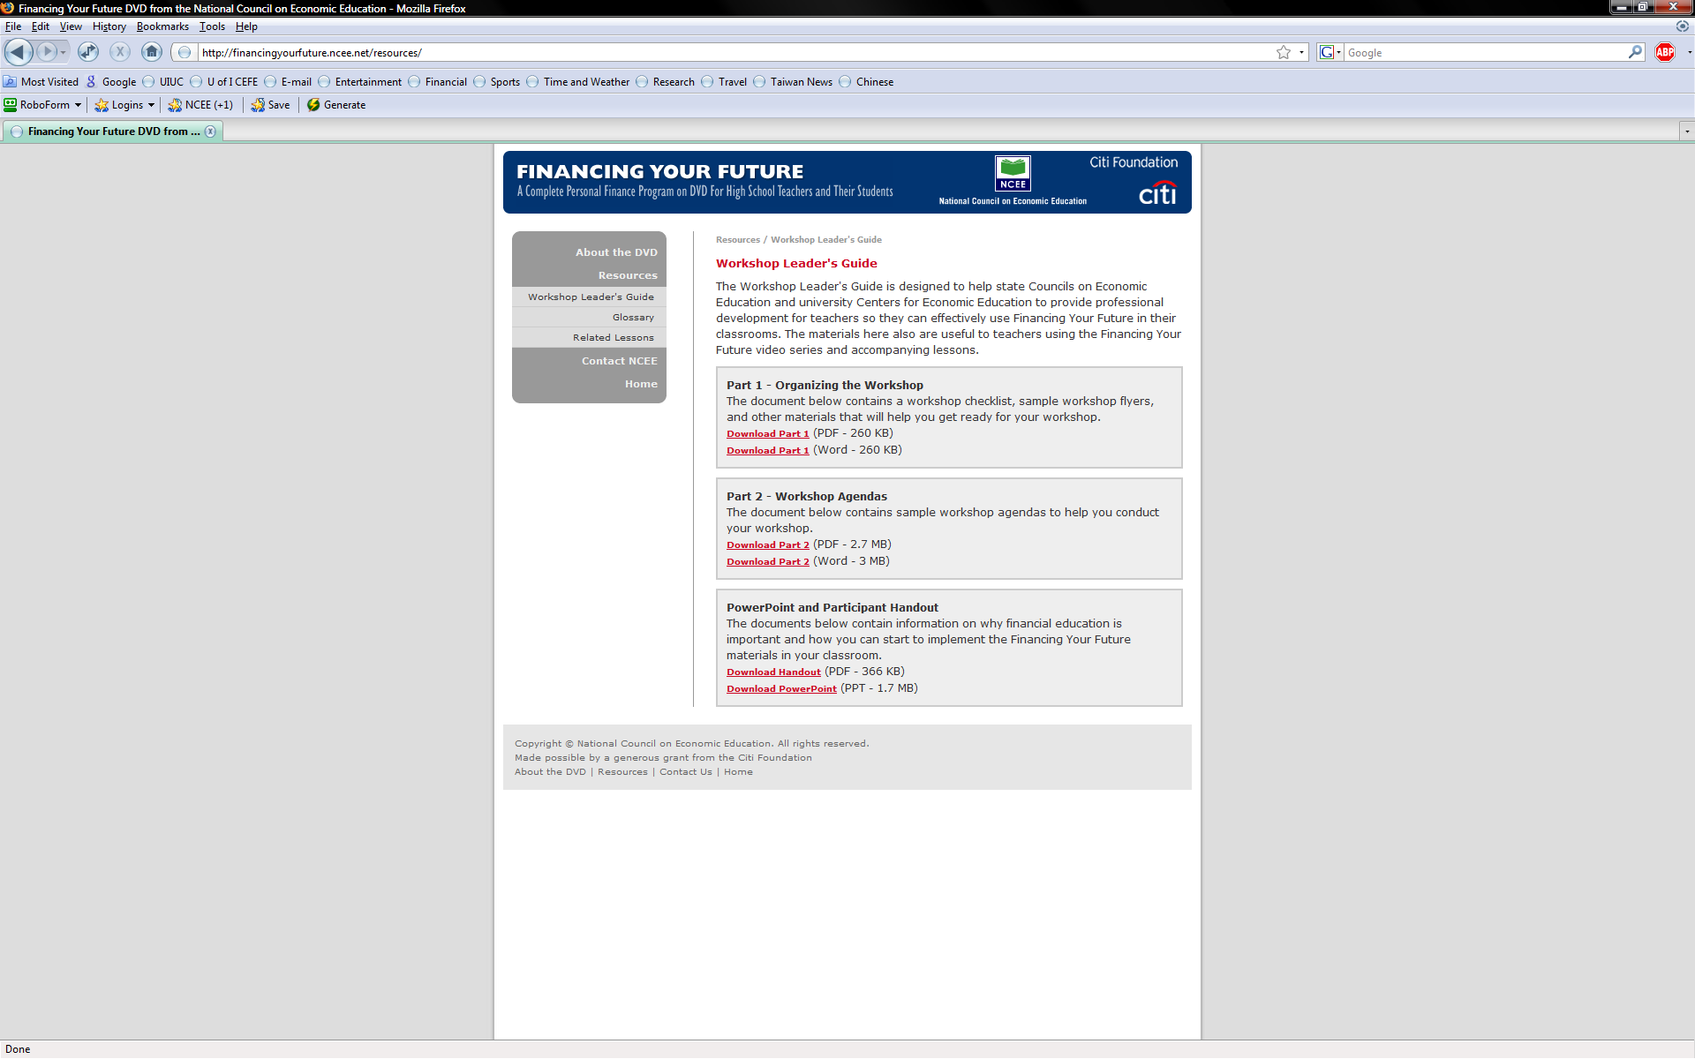
Workshop Leader’s Guide

Slide 9
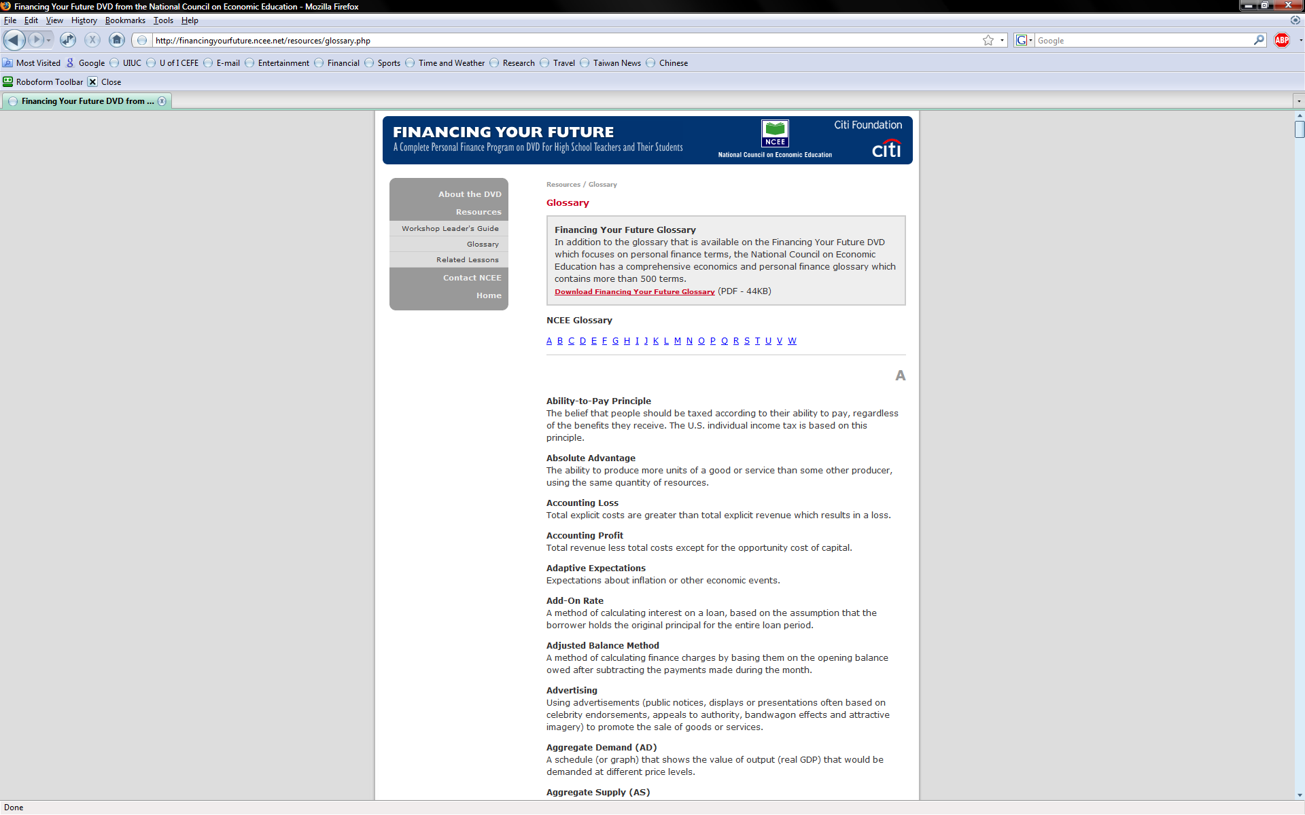
Glossary

Slide 10

Video Summaries
Get a Financial Life (setting financial goals and building wealth)
Get Smart (decisions have consequences)
Get Banked (developing banking relationships)
Get the Credit You Deserve (understanding credit and debt)
Get a Financial Plan (financial planning and saving early and often)

Slide 11
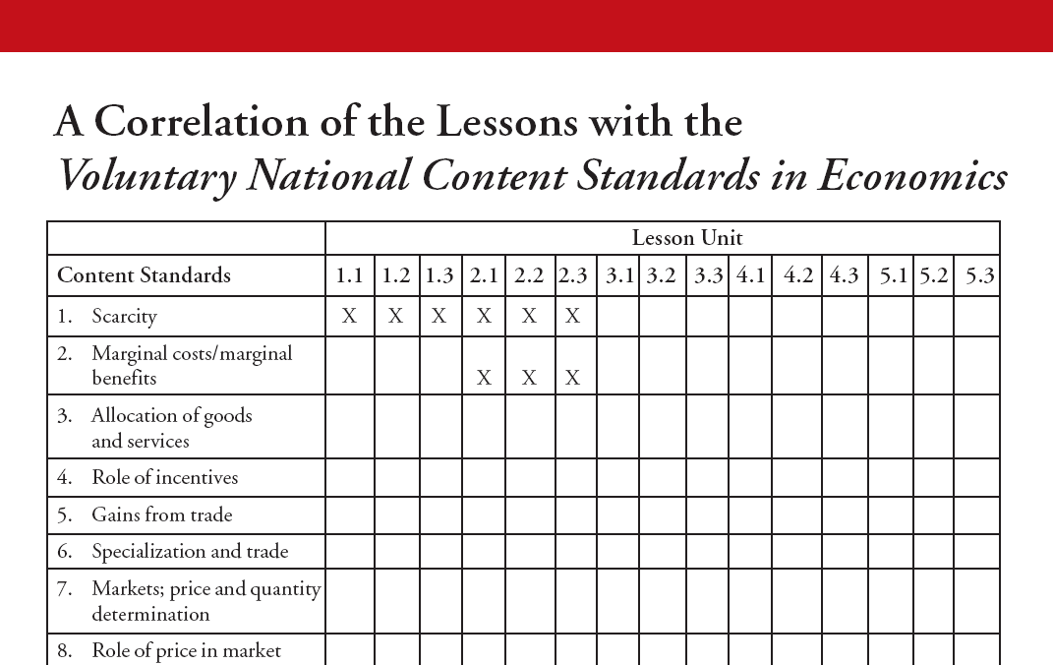
National Standards - Economics

Slide 12
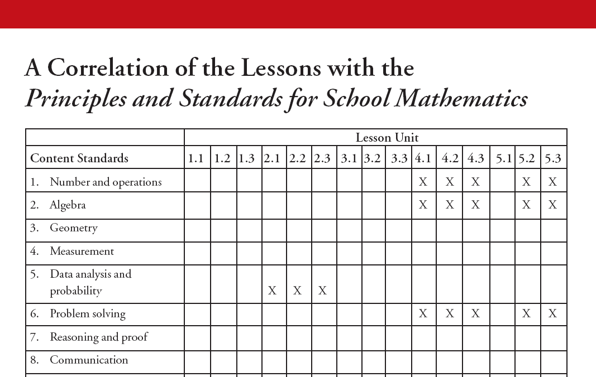
National Standards - Mathematics

Slide 13
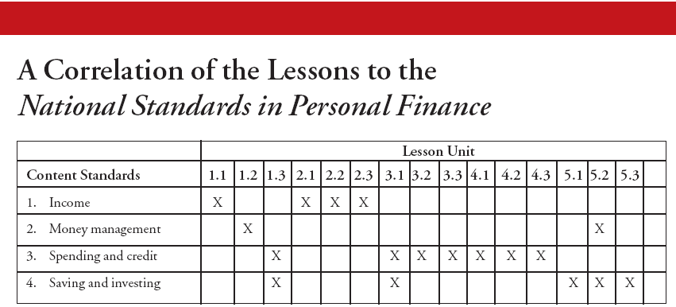
National Standards – Personal Finance

Slide 14

Video 1: Get a Financial Life

Slide 15

Video 1 – Get a Financial Life
3 Lesson Plans
Lesson 1.1: What is a Financial Life?
Lesson 1.2: Setting Financial Goals
Lesson 1.3: Spending Less Than You Earn

Slide 16

Video 1 - Key Concepts
Building wealth
Net worth and savings
Setting financial goals
Short, medium, and long-term goals
Opportunity costs
Spending less than you earn
Income and expenditures

Slide 17
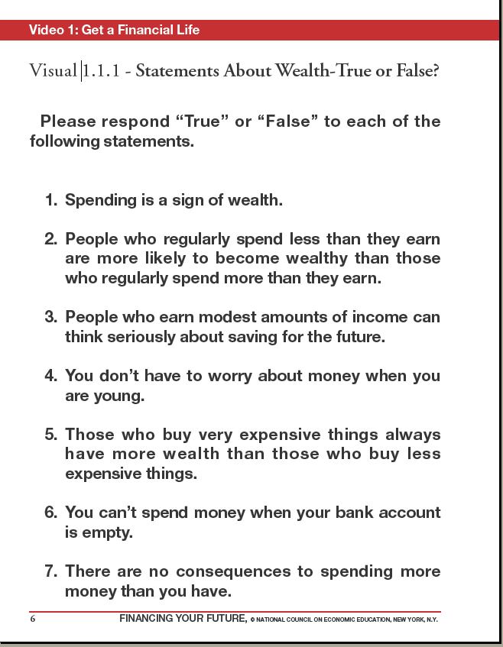
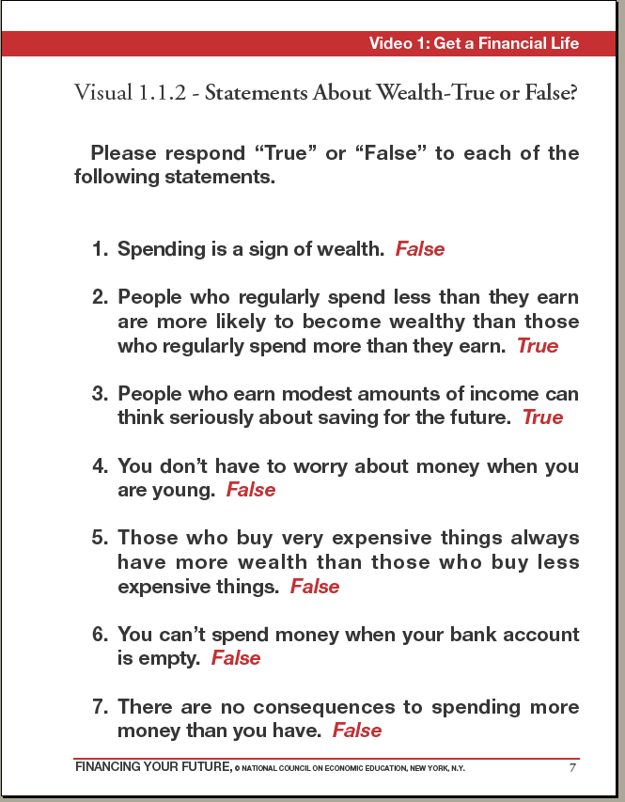
Video 1 – Visuals and Activities

Slide 18
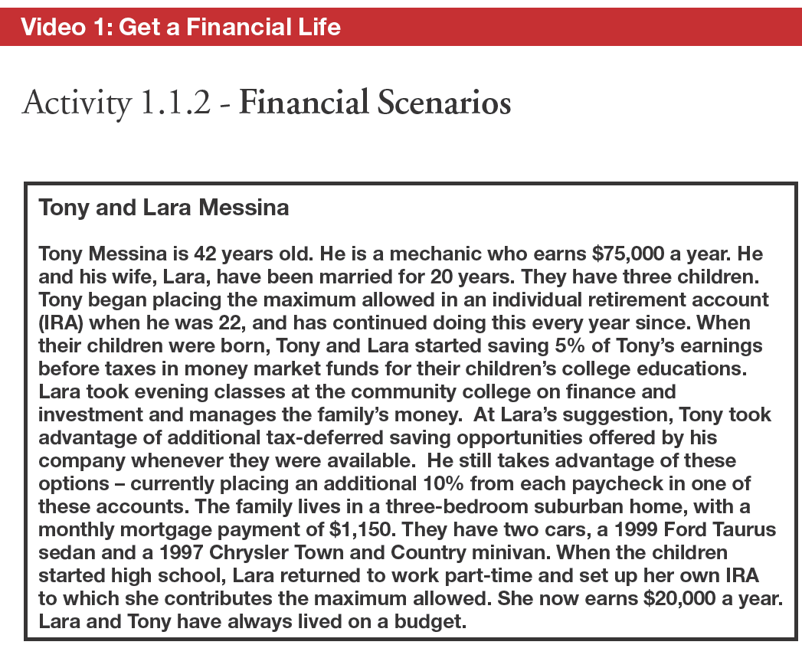

Slide 19

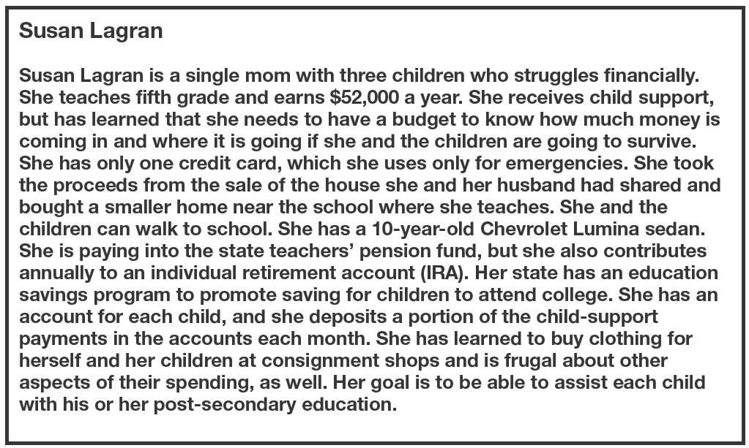
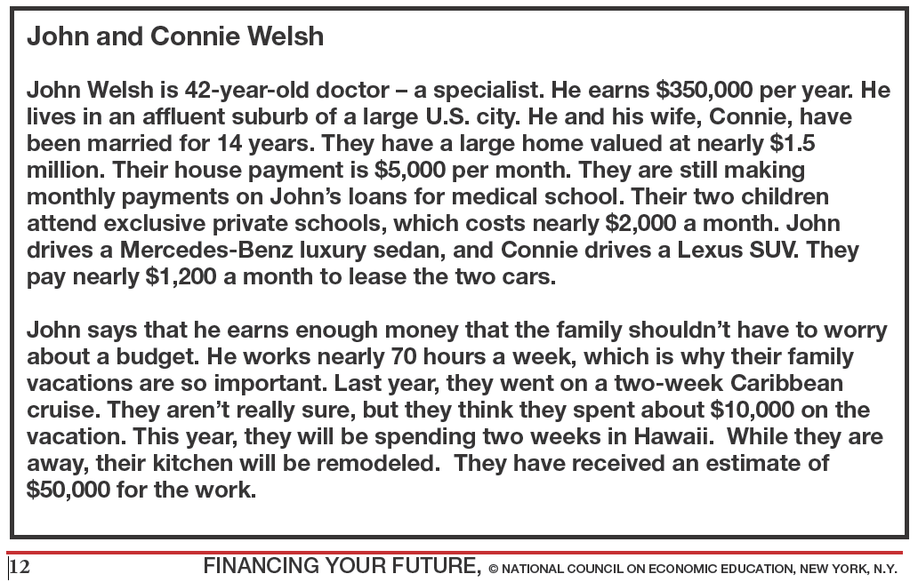
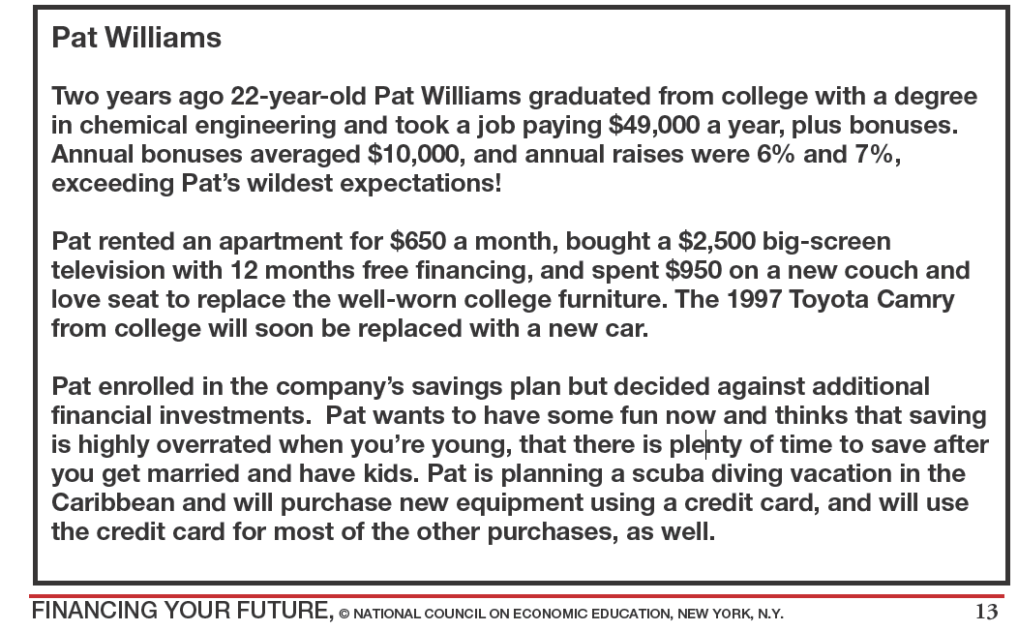

Slide 20
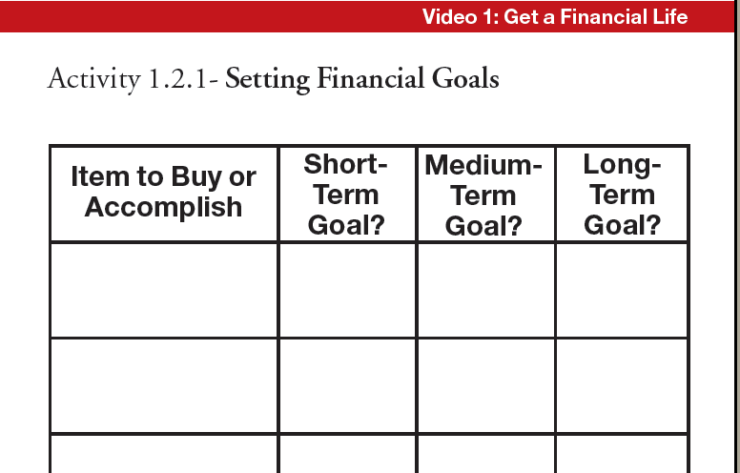

Slide 21
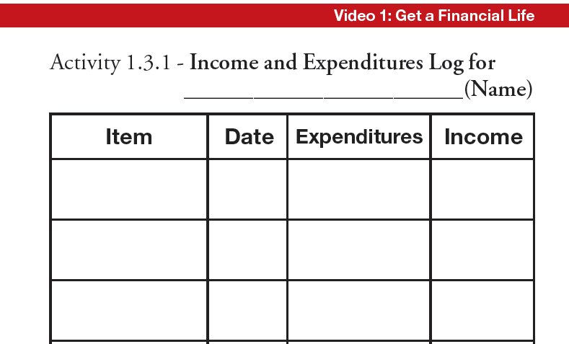

Slide 22
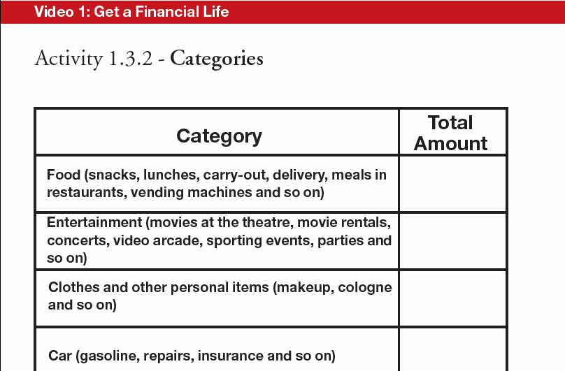

Slide 23

Video 1
Activity 1.1.2 - Financial Scenarios
Divide students/clients into groups.
Assign a financial scenario to each.
Discuss whether saving and investment habits will lead to wealth accumulation, and why or why not.
List factors that add to wealth.
List factors that detract from wealth.
Consider factors not spelled out in the scenario that might change the groups opinion.
Assign someone in each group to report back.

Slide 24

The Millionaire Game
(Financial Fitness for Life)
The Rules:
For each statement, answer “TRUE” or “FALSE.”
For each correct answer, give yourself 5 points.
For each incorrect answer, take away 5 points.
For any 5 statements, you may use your “Millionaire” card. If you answer correctly, you receive 10 points. If not, you lose 10 points.

Slide 25

Let’s Get Started….
Most millionaires are college graduates.
Most millionaires work fewer than 40 hours a week.
More than half of all millionaires never received money from a trust fund or estate.
More millionaires have American Express Gold Cards than Sears cards.
More millionaires drive Fords than Cadillacs.

Slide 26
Most millionaires work in glamorous jobs, such as sports, entertainment, or high tech.
Most millionaires work for big Fortune 500 companies.
Many poor people become millionaires by winning the lottery.
College graduates earn about 65% more than high school graduates earn.

Slide 27
If an average 18-year-old high school graduate spends as much as an average high school dropout until both are 67 years old, but the high school graduate invests the difference in his or her earnings at 8% annual interest, the high school graduate would have $5,500,000.
Day traders usually beat the stock market and many of them become millionaires.
If you want to be a millionaire, avoid the risky stock market.

Slide 28
At age 18, you decide not to smoke and save $1.50 a day. You invest this $1.50 a day at 8% annual interest until you are 67. At age 67, your savings from not smoking are almost $300,000.
If you save $2,000 a year from age 22 to age 65 at 8% annual interest, your savings will be over $700,000 at age 65.
Single people are more often millionaires than married people.

Slide 29
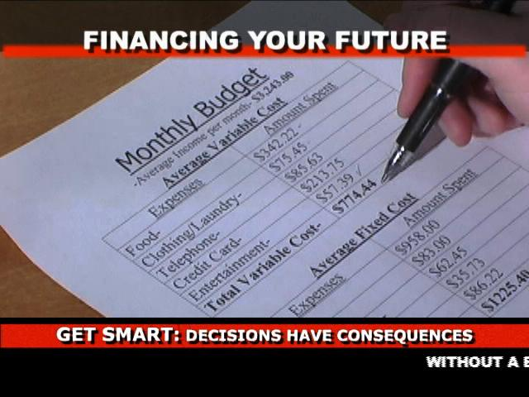
Video 2: Get Smart

Slide 30

Video 2 – Get Smart
3 Lesson Plans
Lesson 2.1: Why Can’t I Have Everything I Want?
Lesson 2.2: Decisions About My Human Capital – What Is It, and How Do I Get Some?
Lesson 2.3: Learning is a Lifetime Investment – Constructing a Career Roadmap

Slide 31
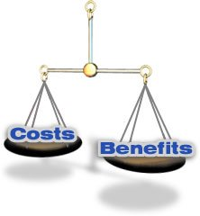
Video 2 - Key Concepts
Decision-making and problem solving
Decisions have consequences
Trade-offs
Opportunity costs
Alternatives
Criteria
Cost/benefit analysis
Human capital

Slide 32
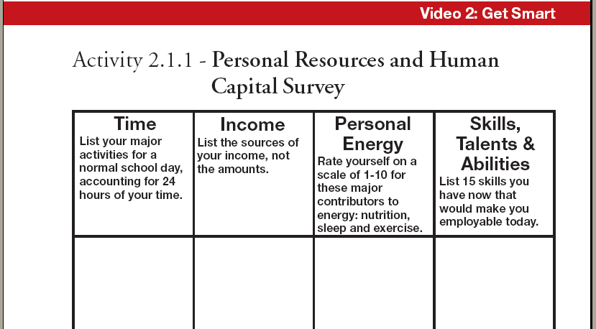
Video 2 – Visuals and Activities

Slide 33
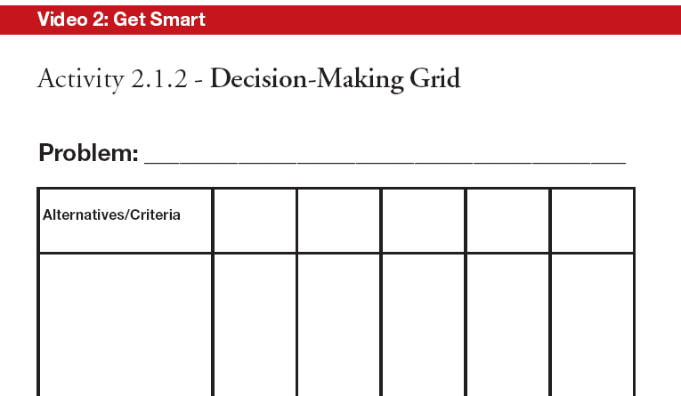

Slide 34
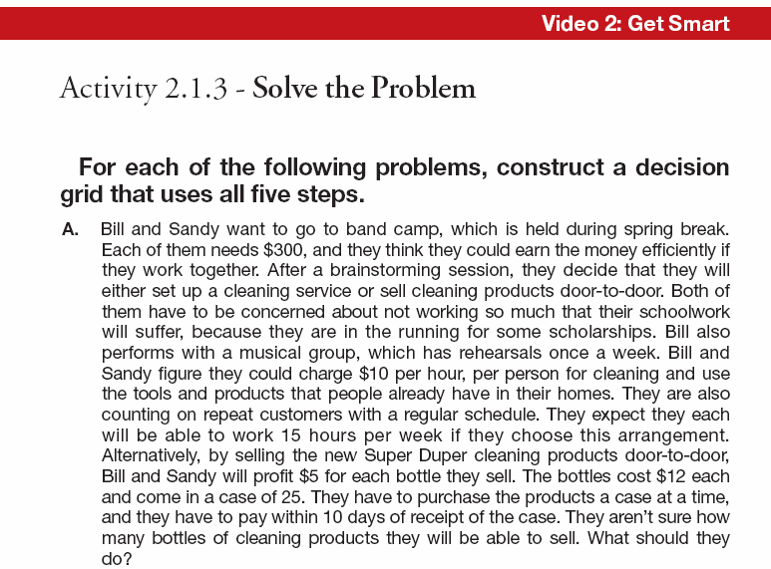

Slide 35
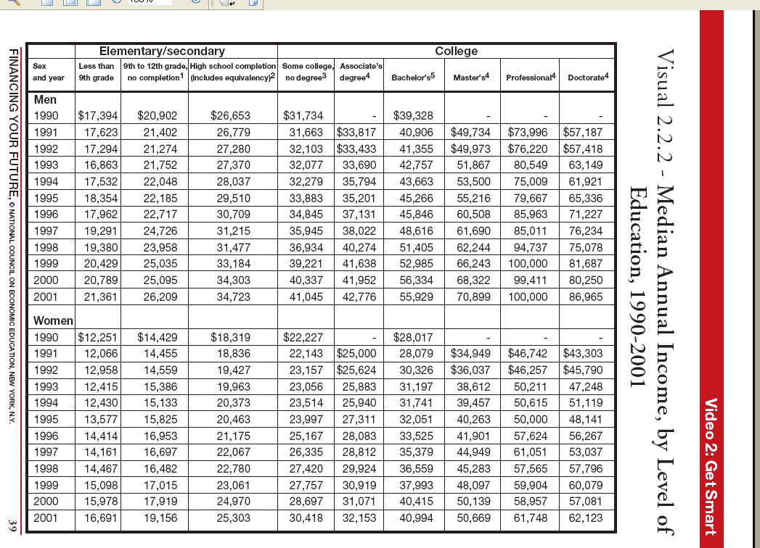

Slide 36
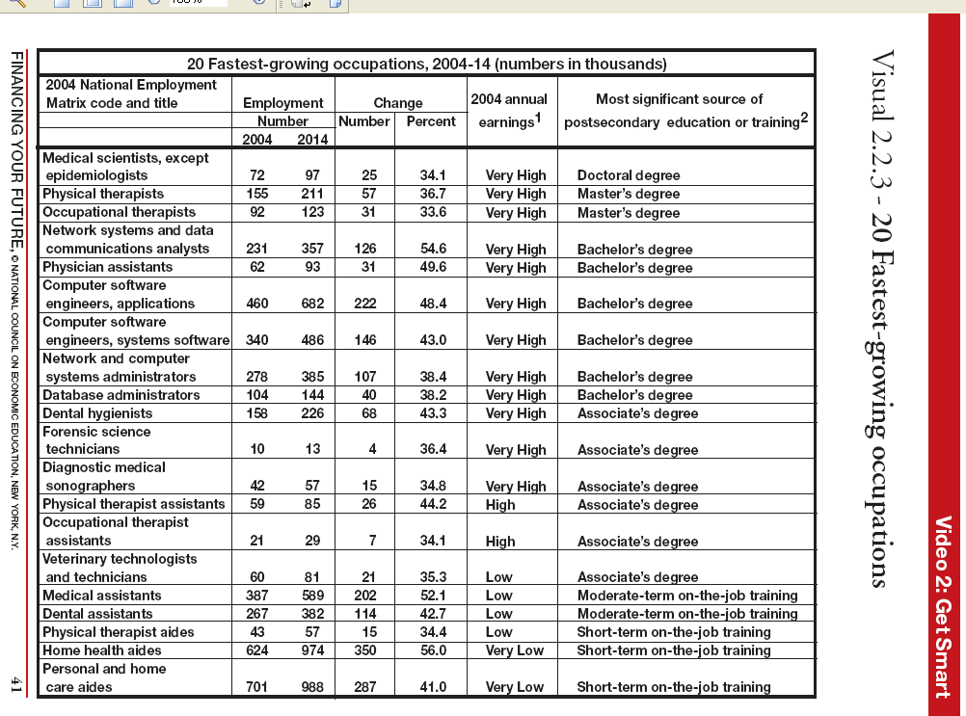

Slide 37
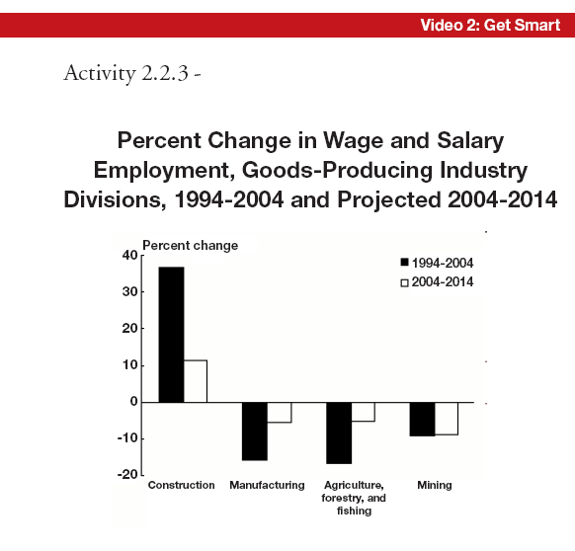

Slide 38
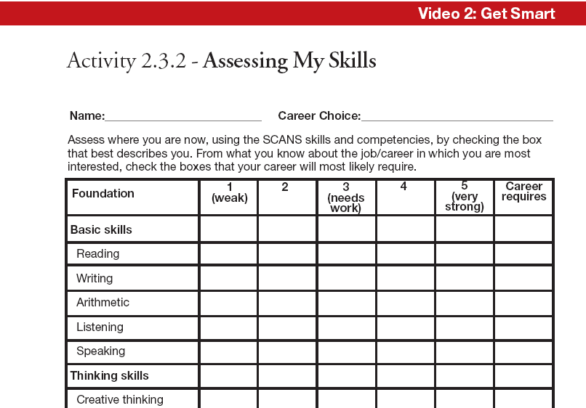

Slide 39
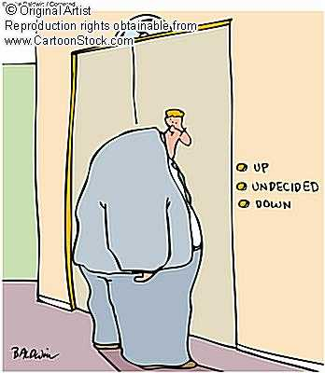

Video 2
Activity – Decision-Making Process
Step 1: Define the Problem.
Step 2: List your Alternatives.
Step 3: Identify your Criteria.
Step 4: Evaluate your alternatives
based upon the criteria.
Step 5: Make a Decision.

Slide 40

Which Cookie is Best?
Criteria Alternatives
A
B
C

Slide 41

Directions
Divide students into groups. Distribute 3 types of chocolate chip cookies to each group. Use A, B, and C in the first column to identify the 3 alternatives (different brands of cookies).
Have students list the criteria they will use to judge the cookies across the top row (i.e., taste, color, aroma, crunchiness).
Have the students taste the 3 different brands of cookies.

Slide 42
Each group then evaluates the alternatives using the criteria and the following scoring:
  1 = lowest (or worst)
  2 = middle
  3 = highest (or best)
Each group makes a decision about their cookie preference and reasons for their preference.
At the end, reveal the brand names, the costs per box, and the cost per unit. Does this information affect their decisions? What are the opportunity costs of selecting their alternative?

Slide 43

Video 3: Get Banked

Slide 44
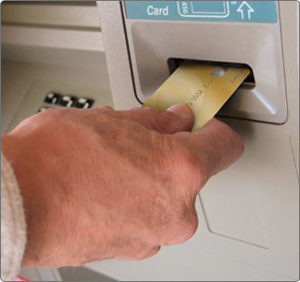
Video 3 – Get Banked
3 Lesson Plans
Lesson 3.1: Why Keep Your Money in a Bank?
Lesson 3.2: The Costs and Benefits of Being Banked
Lesson 3.3: Check, Charge, Debit Card?

Slide 45
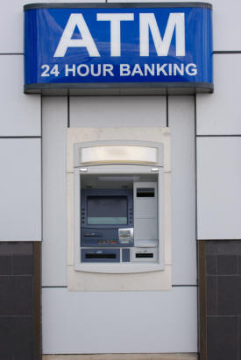
Video 3 - Key Concepts
Banks and credit unions
Checking and saving accounts
Lenders and borrowers
Loans and interest rates
ATM and debit cards
Credit cards
Money orders and cashier’s checks
Traveler’s checks
Smart cards

Slide 46

Video 3 –The Banking Advantage
Illustrates how vital it is to have a banking relationship.
Reveals the surprisingly high cost of being “unbanked.”
Warns of the pitfalls of using pay-day lending and check-cashing establishments.

Slide 47
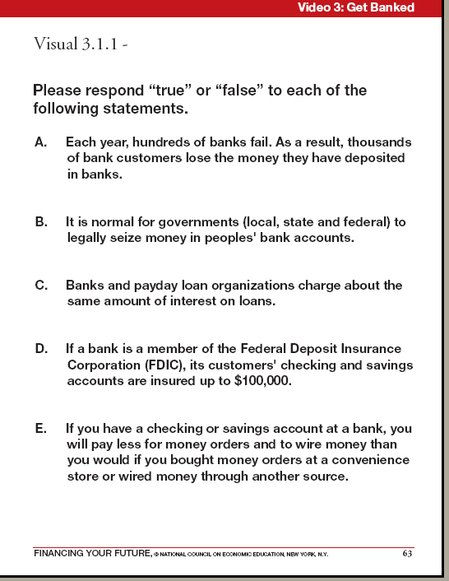
Video 3 – Visuals and Activities

Slide 48
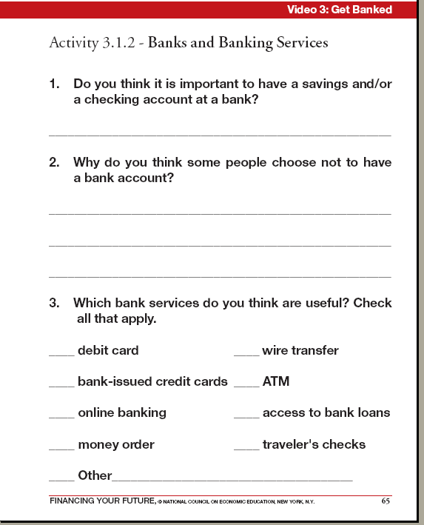
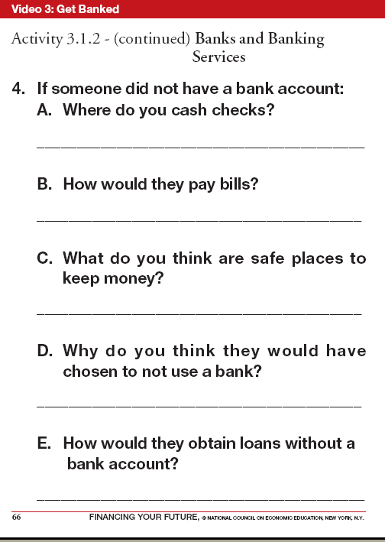

Slide 49
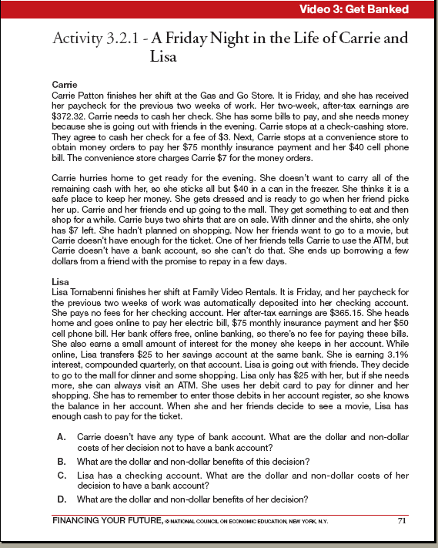

Slide 50
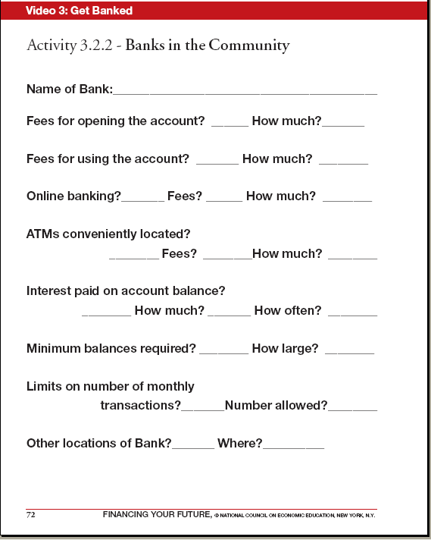

Slide 51
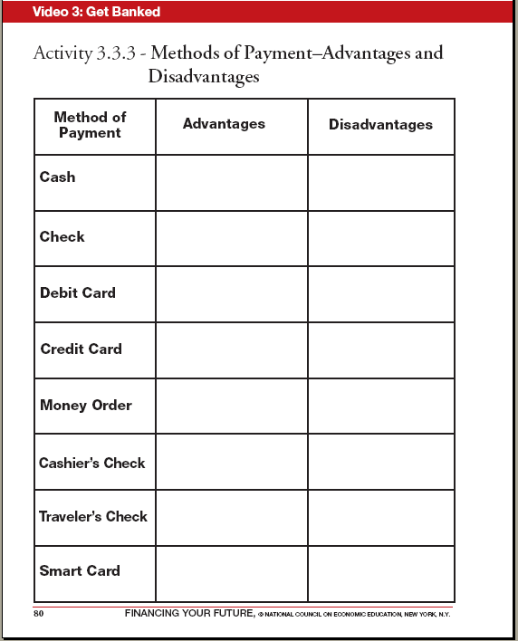

Slide 52
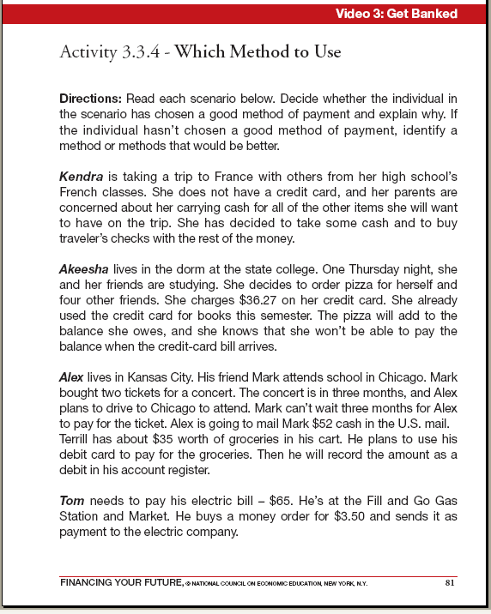

Slide 53

Video 3
Activity 3.2.1 – A Friday Night in the Life of Carrie and Lisa

Slide 54
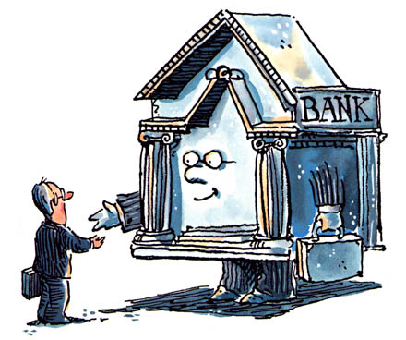
To Bank or Not to Bank?
Carrie doesn’t have any type of bank account. What are the dollar and non-dollar costs of her decision not to have a bank account?
What are the dollar and non-dollar benefits of this decision?
Lisa has a checking account. What are the dollar and non-dollar costs of her decision to have a bank account?
What are the dollar and non-dollar benefits of her decision?

Slide 55

Video 4: Get The Credit You Deserve

Slide 56

Video 4 – Get the Credit You Deserve
3 Lesson Plans
Lesson 4.1: Make Credit Work for You
Lesson 4.2: Credit-Savvy
Lesson 4.3: The Most Important Grade You’ll Ever Earn

Slide 57

Video 4 - Key Concepts
Credit and debit cards
Finance charges
APRs, grace periods, and minimum payments
Installment plans
Open-ended and revolving credit
Credit reports and credit scores

Slide 58
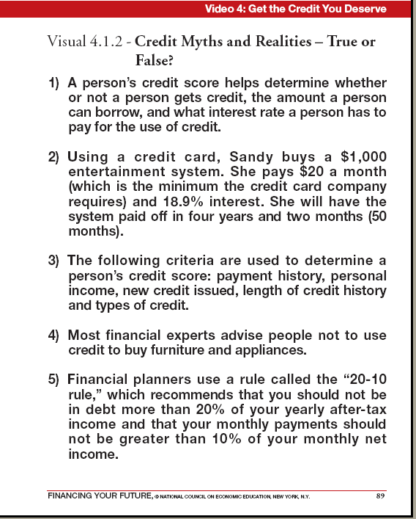
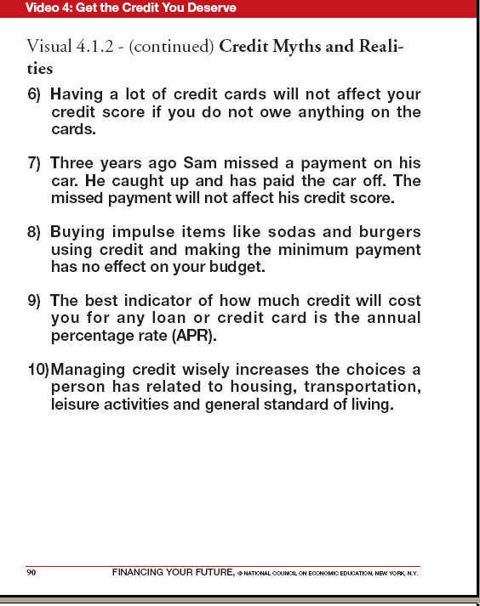
Video 4 – Visuals and Activities

Slide 59
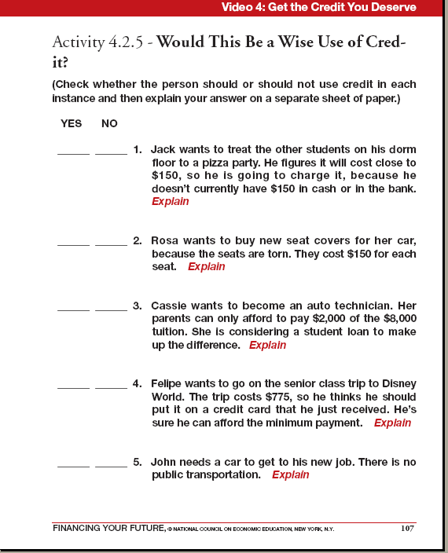

Slide 60
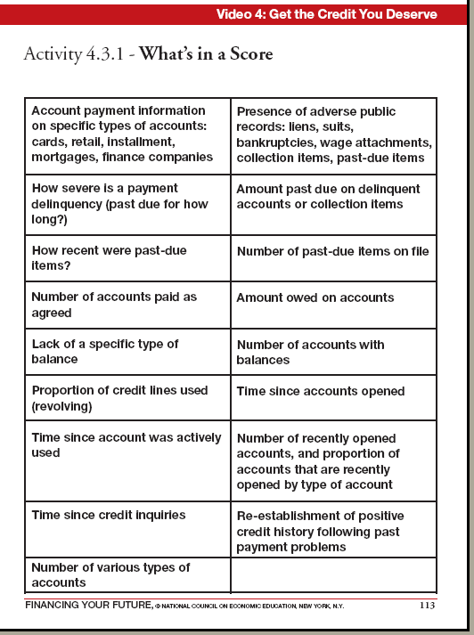
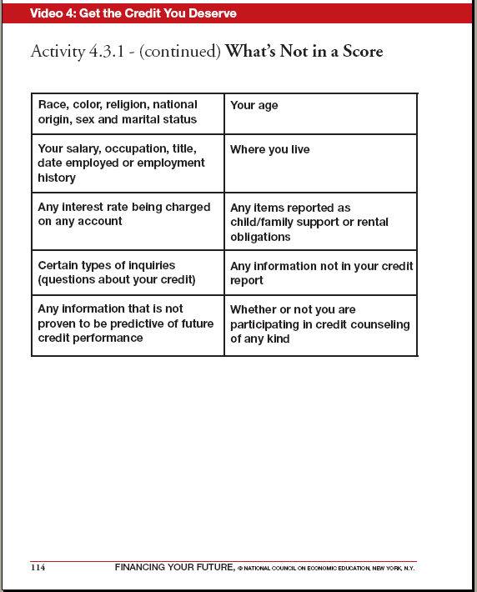

Slide 61

An Activity
Comparing Credit Card Offers

Slide 62
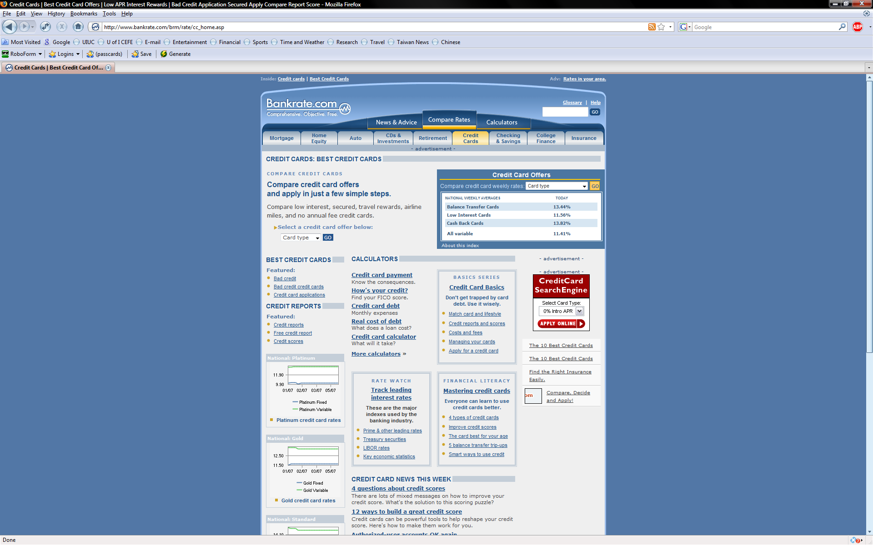
www.bankrate.com
Track rates
Find the best card
Paying the minimum
Paying off balances

Slide 63
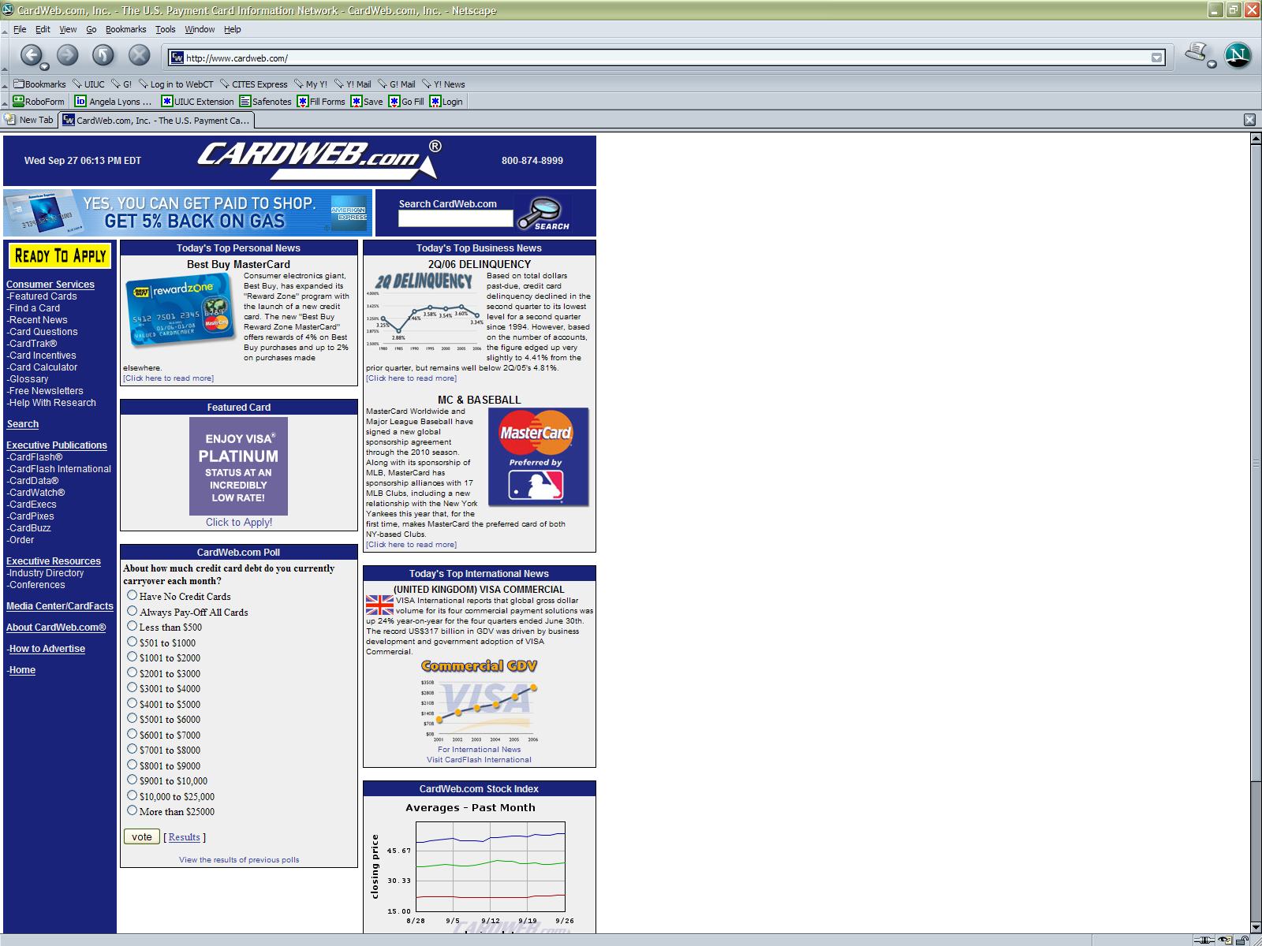
www.cardweb.com

Slide 64
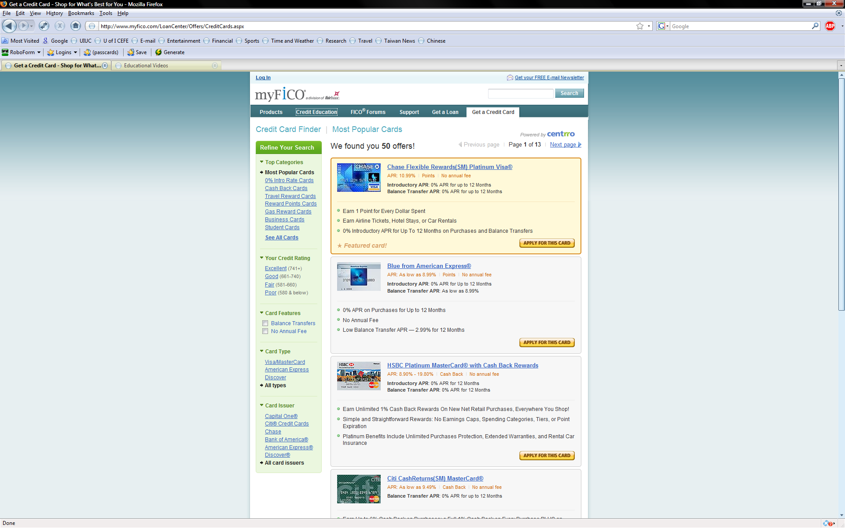
http://www.myfico.com/LoanCenter/Offers/CreditCards.aspx

Slide 65
Take the Credit Report Challenge!
Myths and Realities of Credit Reporting
The Rules:
For each statement, answer “TRUE” or “FALSE.”
For each correct answer, give yourself 5 points.
For each incorrect answer, take away 5 points.
For any 5 statements, you may use your “CREDIT” card. If you answer correctly, you receive 10 points. If not, you lose 10 points.

Slide 66
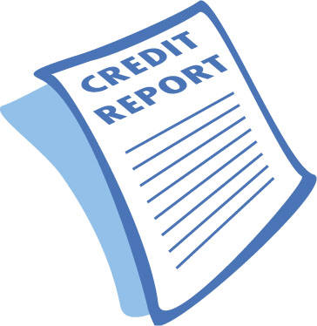
True or False?
Credit reports contain information on where an individual has lived, past employers, and annual income.
Negative information, such as filing for bankruptcy, can remain on a credit report for up to 10 years.
A potential employer is permitted to see an individual’s credit report without his/her consent.
After you take out a loan, a lender is not required to provide information to credit reporting agencies about the loan and your history of paying it back.
Your credit report contains your credit score.

Slide 67
Approximately 20% of an individual’s credit score is determined by their payment history.
Requesting a copy of your own credit report can negatively affect your credit score.
Individuals are eligible to receive a free credit report once a year from each of the three credit reporting agencies.
By law, if an individual is unable to resolve a disputed item with a credit reporting agency, they have the right to delete the information from their credit report.
If an individual resolves an error on their credit report with one credit reporting agency, the same error will automatically be corrected by the other credit reporting agencies.

Slide 68

Understanding Your FICO Score
www.myfico.com

Slide 69
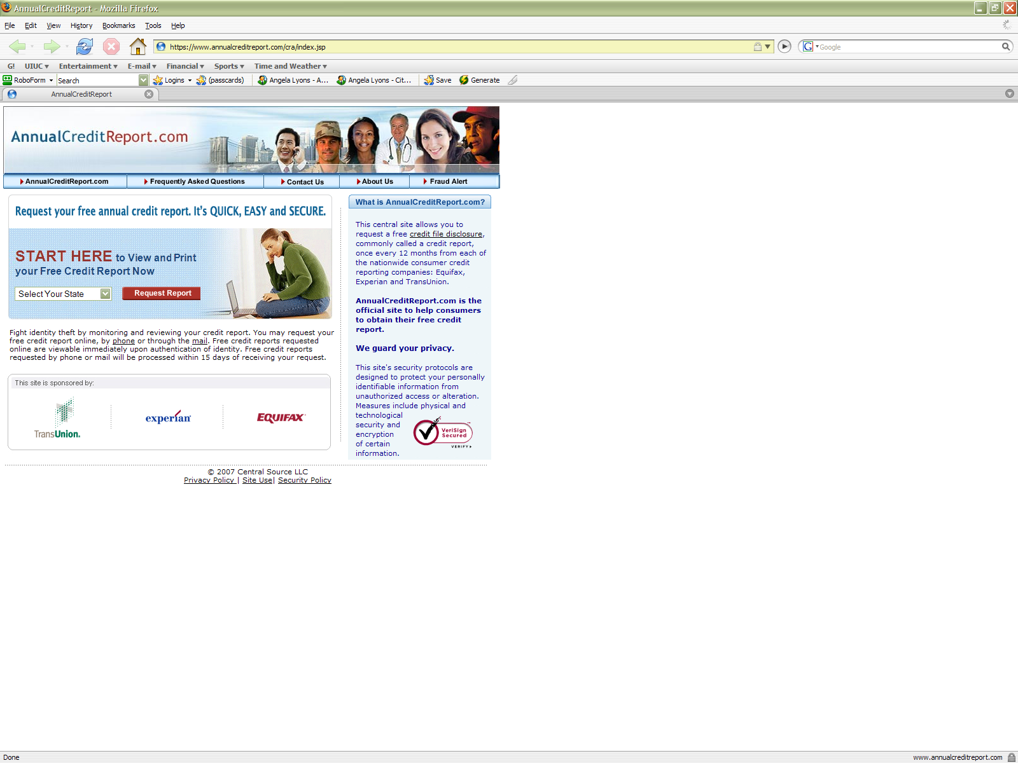
Obtaining a *FREE* Credit Report
www.annualcreditreport.com
1-877-FACT ACT

Slide 70
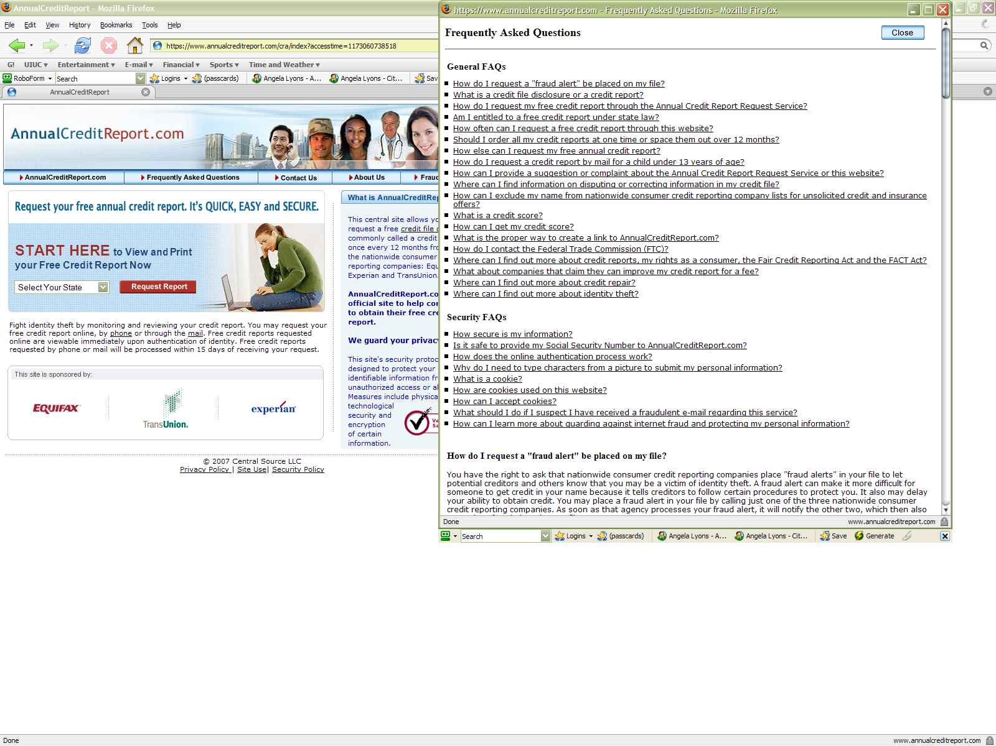
Annual Credit Report
Frequently Asked Questions
Contact Us
About Us
Fraud Alert

Slide 71
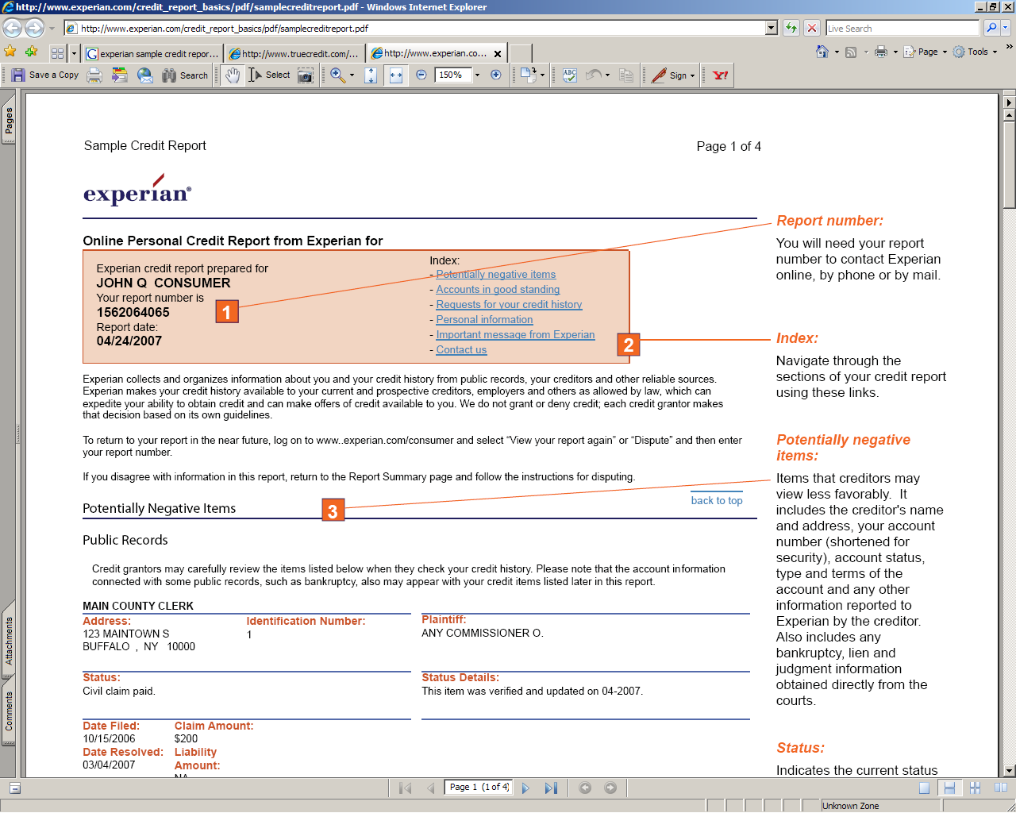
Sample Credit Report:
http://experian.com/credit_report_basics/pdf/samplecreditreport.pdf

Slide 72
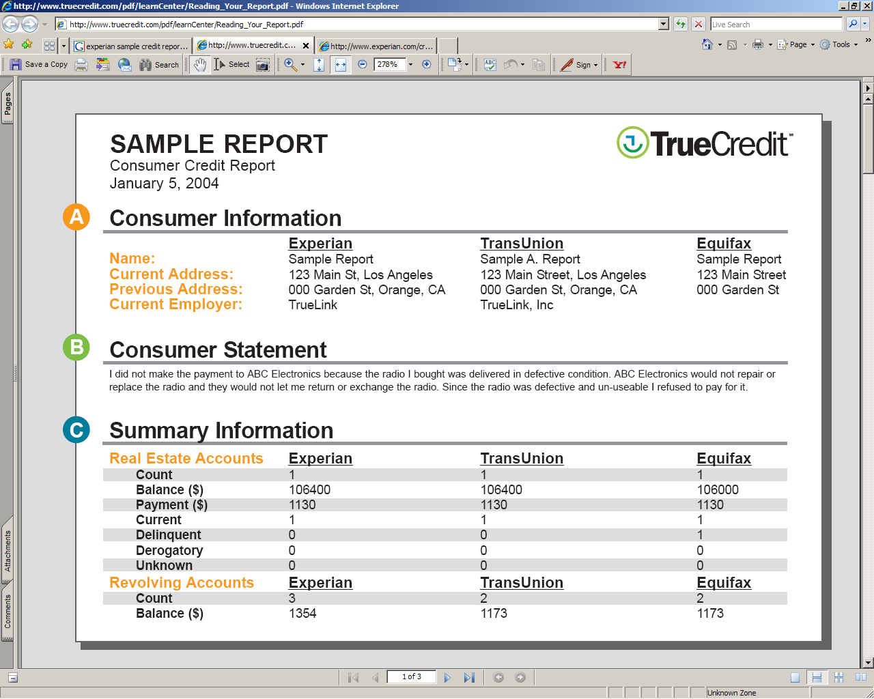
COMPOSITE CREDIT REPORT
http://www.truecredit.com/pdf/learnCenter/Reading_Your_Report.pdf

Slide 73

Video 5: Get A Financial Plan

Slide 74

Video 5 – Get A Financial Plan
3 Lesson Plans
Lesson 5.1: Why Should I Pay Myself First?
Lesson 5.2: How to Create a Financial Plan
Lesson 5.3: Risks and Rewards?

Slide 75

Video 5 - Key Concepts
Saving early and often
Compound interest
Rule of 72
Income, expenses, and budgeting
Fixed vs. variable expenses
Assets, liabilities, and net worth
Types of investment instruments
Risk vs. return
Diversification

Slide 76

Video 5 – Visuals and Activities

Slide 77



Slide 78


Time Value of Money
The earlier you save, the more $$’s you will have.

Slide 79


Slide 80



Slide 81


Slide 82


Slide 83
Forms of Saving and Investing:
Benefits and Costs
Savings accounts:
provide a small but steady return.
Certificates of deposit:
very safe, but instant access carries a penalty.
Bonds:
lending money to a corporation or government, with a promise of higher returns than those offered by bank savings accounts and CDs.
Stocks:
part ownership in a company, offering higher risks and, potentially, higher returns than some other investments.
Real estate:
the risks and benefits of being a landlord.

Slide 84
Risk Pyramid

Slide 85

Video 5
Activity – Trade-Off Between Risk and Return
(Learning, Earning, and Investing)
Floor Markers:
  Mattress
  Savings Accounts
  CDs
  Bonds
  Stocks
  Mutual Funds
  Real Estate

Slide 86
Investment Situations:
Which Form Will You Choose?
You have $5,000 to invest. No other information is available.
You have $4,000 that you’ll need six months from now.
You inherited $10,000 from your great-aunt; she has suggested that you save it for use in your old age.
You are just starting a career and can save $50 per month for retirement.
A new baby arrives, and Mom and Dad plan to save $100 a month for the child’s college education.

Slide 87


Slide 88



Other Resources
University of Illinois Extension
Consumer and Family Economics
www.ace.uiuc.edu/cfe
National Council on Economic Education
www.ncee.net
Illinois Council on Economic Education
www.econed-il.org

Slide 89

University of Illinois Extension
Consumer and Family Economics
www.ace.uiuc.edu/cfe

Slide 90

NCEE
www.ncee.net

Slide 91

www.ace.uiuc.edu/financialed

Slide 92

Questions

